Slide 1

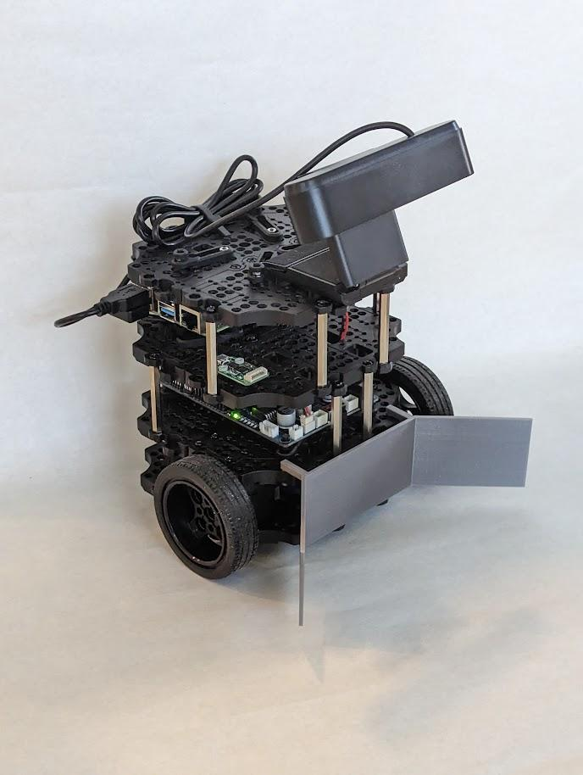

NibblesBot
Ethen Carrell
Charles Moertle
Calab Reeder

Slide 2
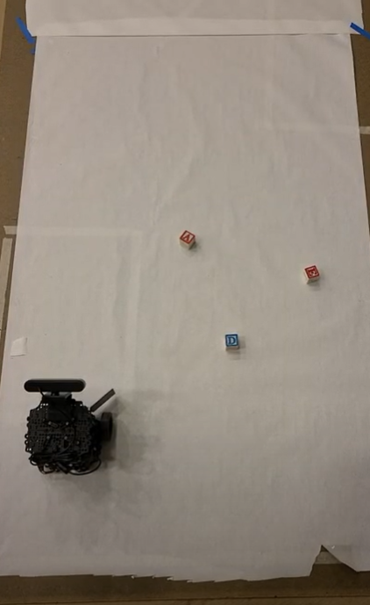
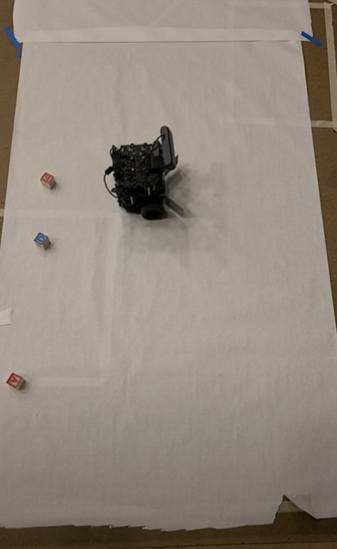
Refresher: Task and Environment

Slide 3
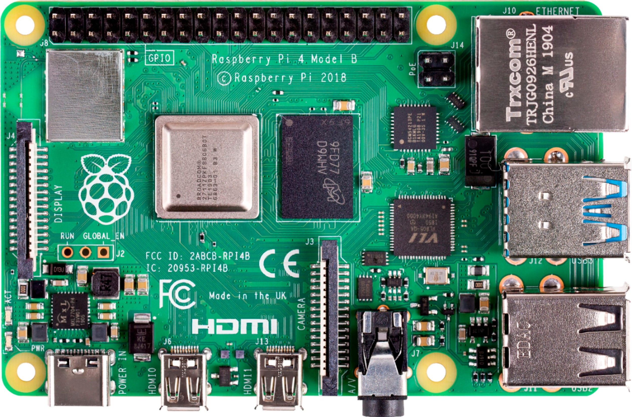
Refresher: Components
Drive systems
Camera
Pi 4 B

Slide 4
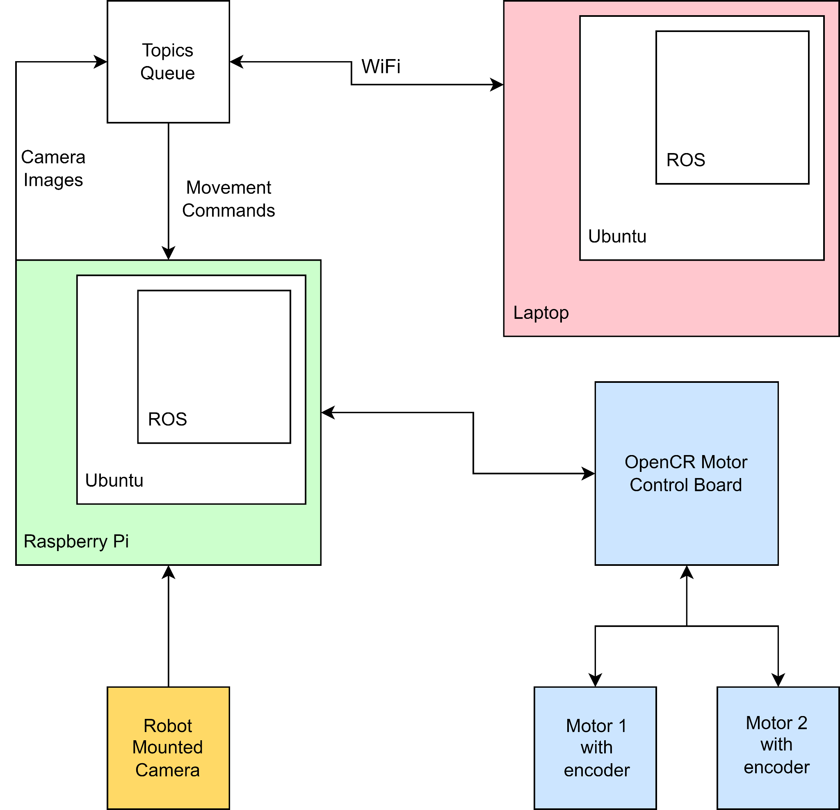
Block Diagram
Removed god cam
Color coded

Slide 5
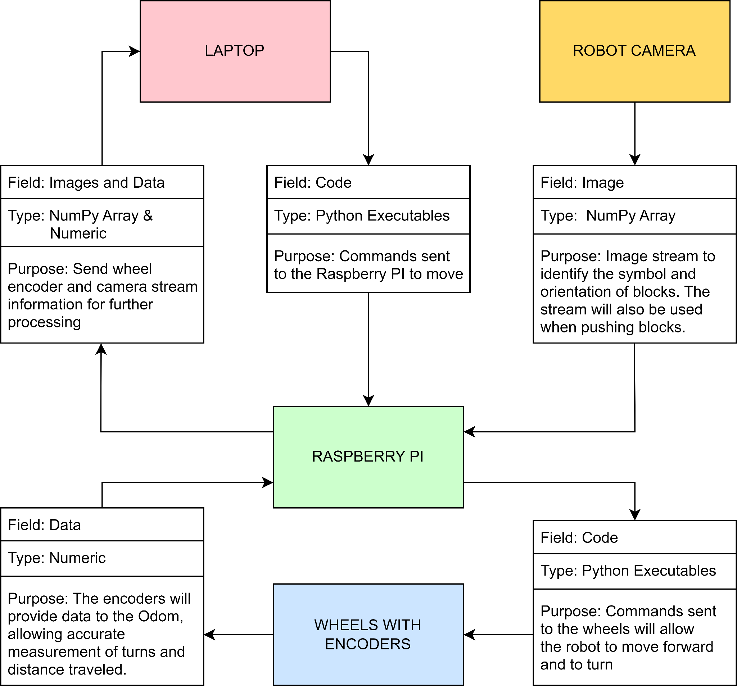
Message Diagram
Updated image type
Color coded

Slide 6
Changes/Deviations
Removal of LiDAR
Removal of God Camera
Use of Canny instead of ORB with dynamic cropping
Canny was more accurate and stable
Color masking with ORB
Change from Virtual Machine to Dual Boot

Slide 7
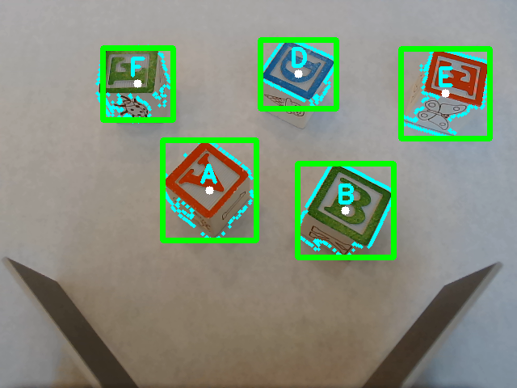
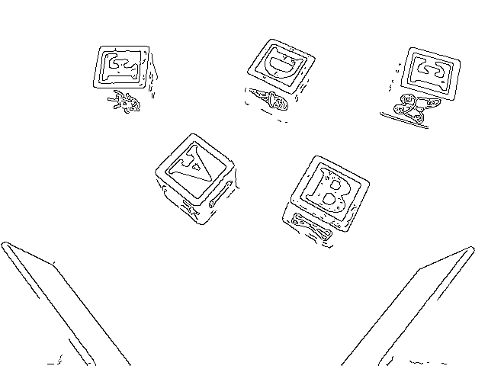
Changes/Deviations: Computer Vision
ORB with Canny
Inverted Canny

Slide 8
Completed Accomplishments (Pre-Test)
Complete physical build of the robot including modifications
Complete software installation
Computer vision implementations of ORB and Canny Edge Detection
Centroid and initial detection with Canny
Dynamic Cropping with Canny
ORB feature detection with color masking

Slide 9
Completed Accomplishments (Testing)
1 block test without searching algorithm
NibblesBot drives forward and halts once it finds the block placed directly in front of it.
1 block test with searching algorithm
NibbesBot searches to find a single block in the designated search area
NibblesBot will find the block and return to the start point with the block
More than 1 block test with searching algorithm
NibblesBot searches to find a single block
NibblesBot takes the block to a staging area
NibblesBot returns to where it found the block and resumes search
Continues until both blocks are in the staging area

Slide 10
Partially Complete Accomplishments
Organization of blocks at staging point
NibblesBot is able to bring the blocks to the staging point
NibblesBot is not able to physically organize the blocks
State machine implementation of our code
Logic for the state machine does not work and is still underdevelopment

Slide 11
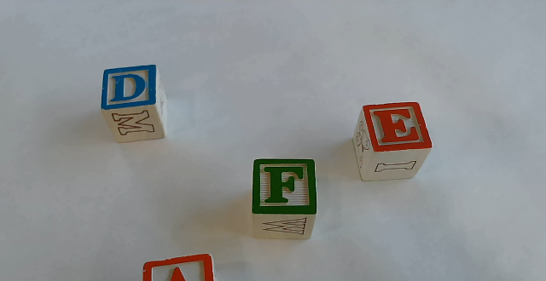
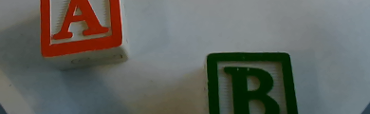
Future Implementations: Use all of Frame
Above cow catcher →
Potential uses:
Only run ORB through inside catcher
Use area to rotate the blocks
Use area to confirm whether a block has been captured
Inside cow catcher →

Slide 12

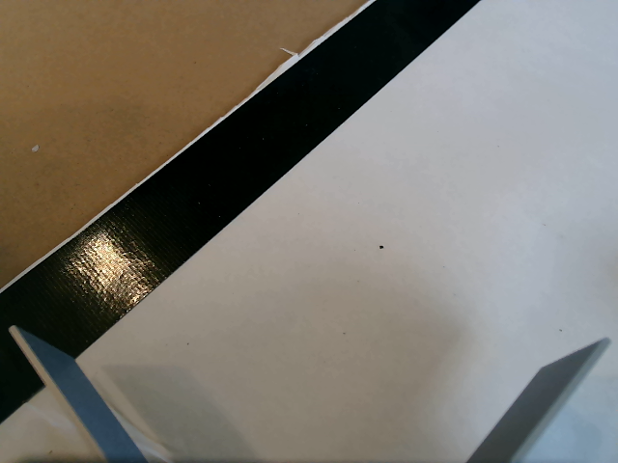
Future Implementations: Mask for Border
Masked and inverted
Normal frame

Slide 13
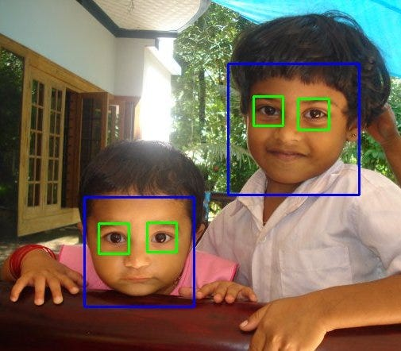
Future Implementations: Haar Cascade
Haar Cascade is a object detection algorithm that is able to find objects in an image regardless of scale or location.
Training requires a series of positive and negative
images to influence the types of objects that
will be detected
Positive images for NibblesBot:
Blocks in different orientations
Negative images for NibblesBot:
Cow catcher
Black tape border
White background

Slide 14
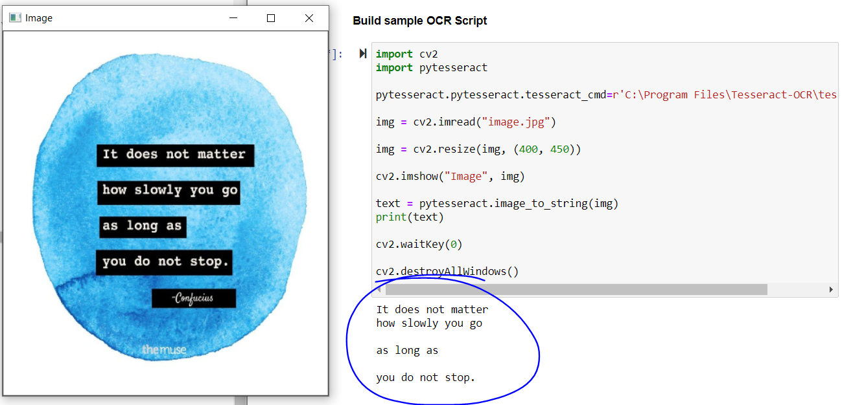
Future Implementations: PyTesseract
Looks at an image and finds all the characters in that image

Slide 15
Future Implementations: PyTesseract
Training a new font for PyTesseract requires three things:
An image
Text file
Contains plain text of the characters in an image
Box file
Holds the position of desired letters in an image
Unicharset file
Gives more information about the individual letters that need to be trained on
Then create thousands of these files and training images and train your model on those files.
Box file example
D 101 504 131 535 0
e 135 502 154 528 0
r 158 503 173 526 0
„ 197 497 214 510 0
s 220 501 236 526 0
c 239 501 258 525 0
h 262 502 284 534 0
n 288 501 310 525 0
e 313 500 332 524 0
l 336 501 347 534 0
l 352 500 363 532 0
e 367 499 386 524 0
” 389 520 407 532 0
Unicharset file example
; 10 Common 46
b 3 Latin 59
W 5 Latin 40
7 8 Common 66
= 0 Common 93
Text file example →
Der “schnelle”

Slide 16
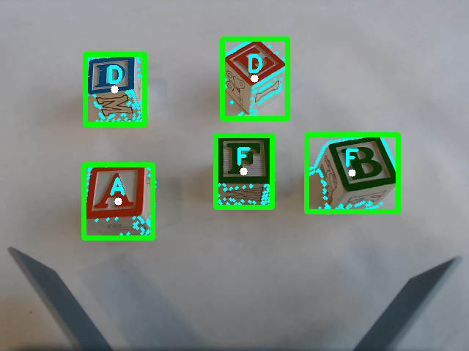
Unresolved Issues
Uneven lighting causes issues for block identification and Canny
Major impact as this affects the accuracy of all computer vision algorithms used
When searching, two blocks cannot be in the same frame or Canny will break
Minor impact only because we can manually space the blocks far enough so that this never happens
3) Rotating the blocks to the correct orientation
Minor impact as the blocks can still be moved to the correct position

Slide 17
Sources
“Feature Matching.” OpenCV, https://docs.opencv.org/4.x/dc/dc3/tutorial_py_matcher.html.
“Teach Ros Effectively.” The Construct, https://www.theconstructsim.com/for-campus/
Tyagi, Deepanshu. “Introduction to Orb (Oriented Fast and Rotated Brief).” Medium, Data Breach, 1 Jan. 2019, https://medium.com/data-breach/introduction-to-orb-oriented-fast-and-rotated-brief-4220e8ec40cf.
Bonthu, Harika. “Optical Character Recognition(Ocr) with Tesseract, Opencv, and Python.” Analytics Vidhya, 24 June 2021,https://www.analyticsvidhya.com/blog/2021/06/optical-character-recognitionocr-with-tesseract-opencv-and-python/.
Jaiswal, Abhishek. “Object Detection Using Haar Cascade: Opencv.” Analytics Vidhya, 27 Sept. 2022, https://www.analyticsvidhya.com/blog/2022/04/object-detection-using-haar-cascade-opencv/.

